Slide 1
The Impact of AI-Supported Learning on Financial Literacy: Evidence from a Randomized Controlled Trial
Preliminary Results
Jaime Polanco-Jimenez¹ & Kristof De Witte²
¹ LEER - KU Leuven & Pontificia Universidad Javeriana, Colombia
² LEER - KU Leuven, UNU-Merit & Maastricht University

Slide 2
Outline
Brief overview
Contribution
Methodology
Data
Results
Robustness Check and Attrition Selection
Conclusions

Slide 3
This paper
Question: Can Generative AI tools improve financial literacy outcomes in the Belgian secondary school context?
Is this effect different in the context of teacher shortages?
Motivation: Financial literacy is crucial for economic well-being (Behrman et al., 2012), and interventions can influence student economic preferences (Sutter et al., 2020).
How:
RCT identifying the causal effect of AI chatbots vs. a traditional learning path.
Comparing: Control (Traditional Learning Path) vs. Treatment 1 (Reduced TLP + AI) vs. Treatment 2 (Tailored AI)
Data from N=2236 students in Belgium that have started the learning path.
We find:
Main outcome: Increase 0.07 sd (T1) and 0.04 sd (T2) relative to Control.
Psychosocial and Emotional Outcomes: AI is “as good as” the traditional path

Slide 4
Contribution
1

Slide 5
Contribution: Pioneering AI in Financial Literacy Education
While general AI in education is a rapidly expanding field (e.g., Tlili et al., 2025; Wang et al., 2024), key gaps remain.
Novelty: This study, to our knowledge, is the first to:
Investigate the causal impact of AI tools on financial literacy education.
Assess “Psychosocial and Emotional Outcomes”, → extending beyond typical academic measures in AIEd¹ studies (Tlili et al., 2025).
Provide such evidence from the Belgian secondary school system.
Tailored vs. Generic AI Chatbots: Moves beyond studying general chatbot efficacy (Wu and Yu, 2023).→ hyper-tailored to the complex domain of the Belgian tax system.
¹Artificial Intelligence in Education (AIEd)

Slide 6
Contribution: Methodological Rigor & Nuanced Investigation
Quantifying Impact: Provides clear, statistically significant effect sizes (0.04-0.07 sd). This enhances the evidence base in a field where precise impact quantification of AI interventions can often be limited.
Beyond Academic Scores: Provides a holistic view by measuring impacts on motivation, self-regulation, and engagement, extending beyond typical academic outcome measures.
¹Artificial Intelligence in Education (AIEd)

Slide 7
Methodology
2
7
Faculty, department, unit ...

Slide 8
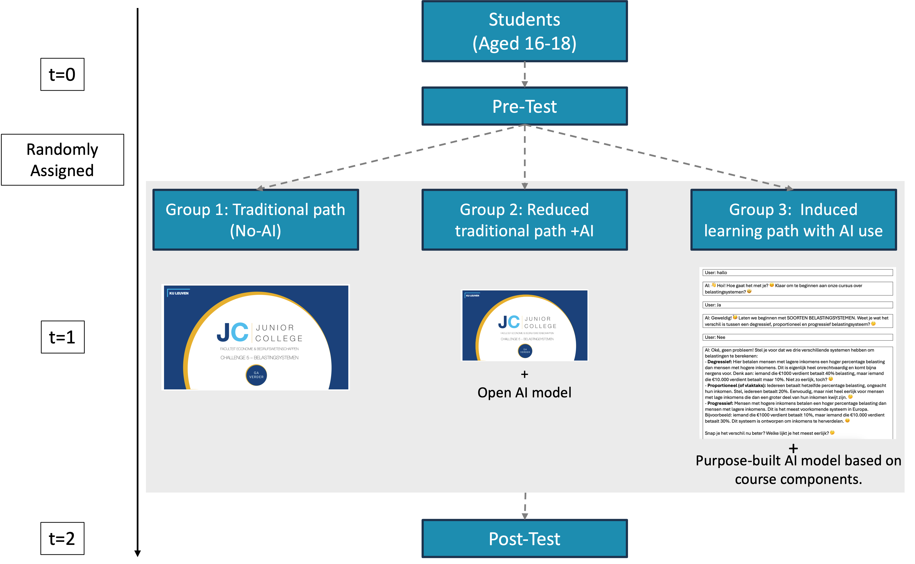
A Multifaceted Picture (Summary of Evidence)
The sample size of 732 was determined by a power analysis (α = 0.05, power = 0.80), assuming a medium effect size (Cohen’s d = 0.2) for the primary outcome: the post-test score difference between the combined AI groups and the control group.

Slide 9


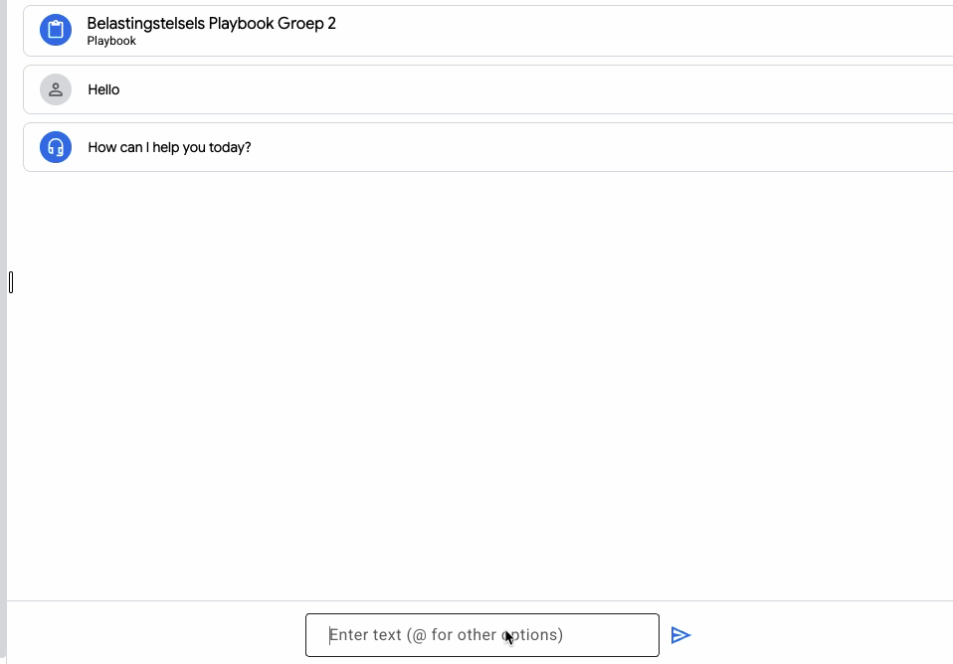

Treatment Group 1: AI – Supplemented Traditional Materials
+

Slide 10
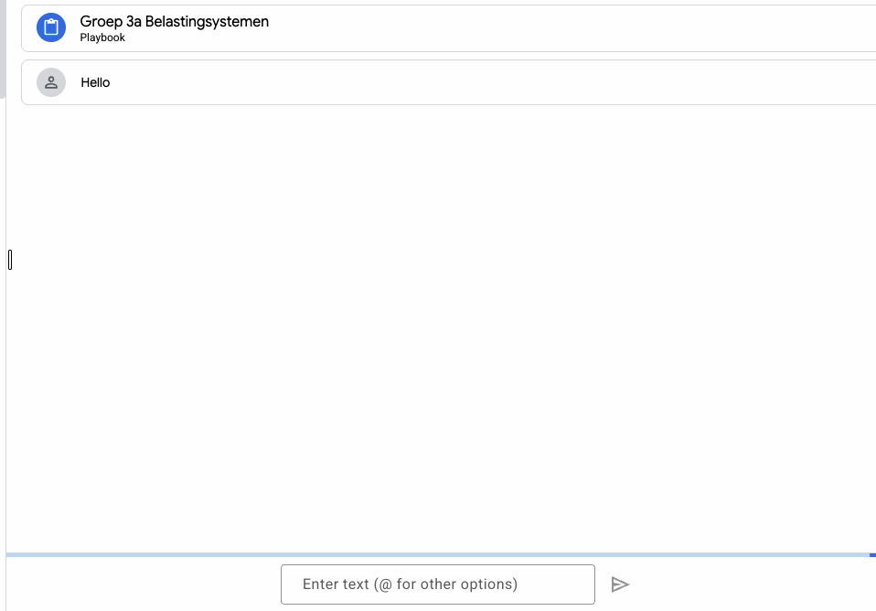
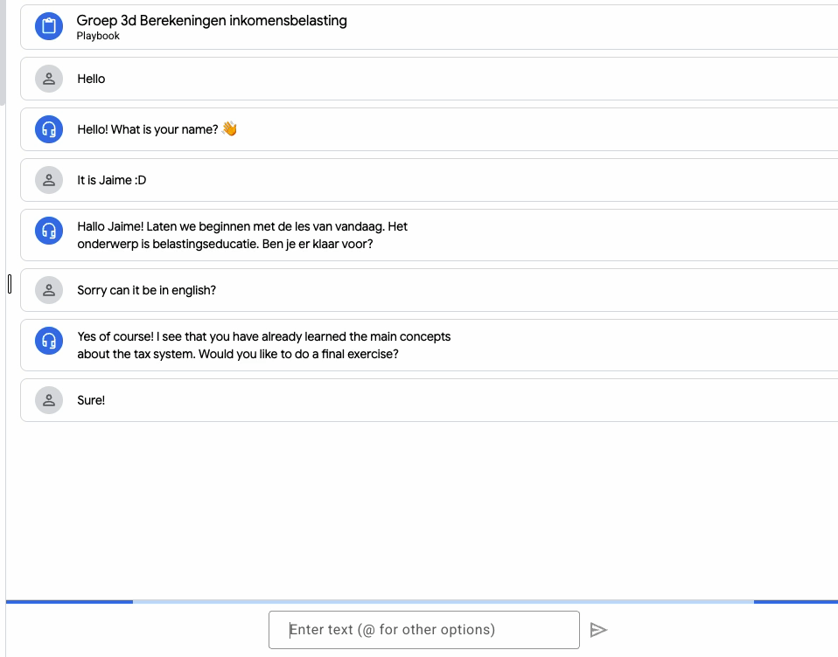
Treatment Group 2: Tailored AI

Slide 11
Data
3
11
11
Faculty, department, unit ...
Faculty, department, unit ...

Slide 12
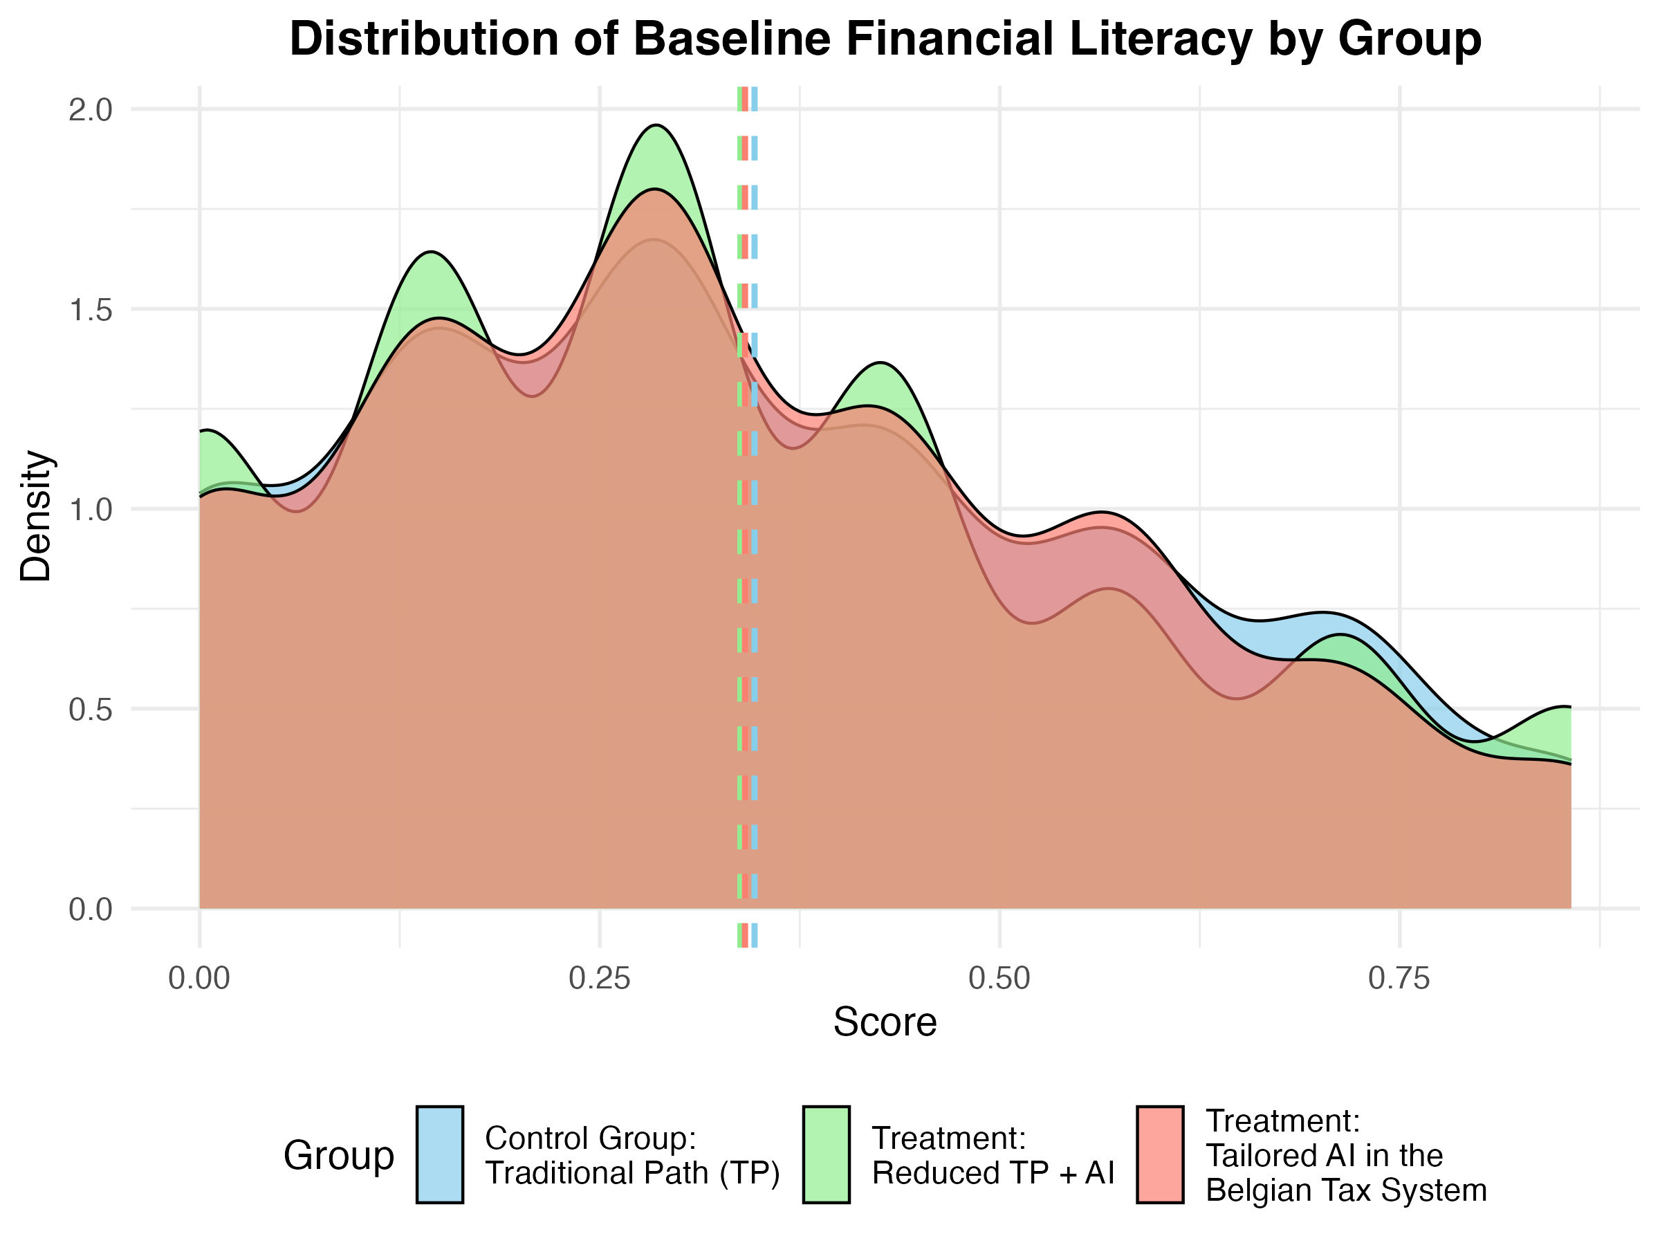
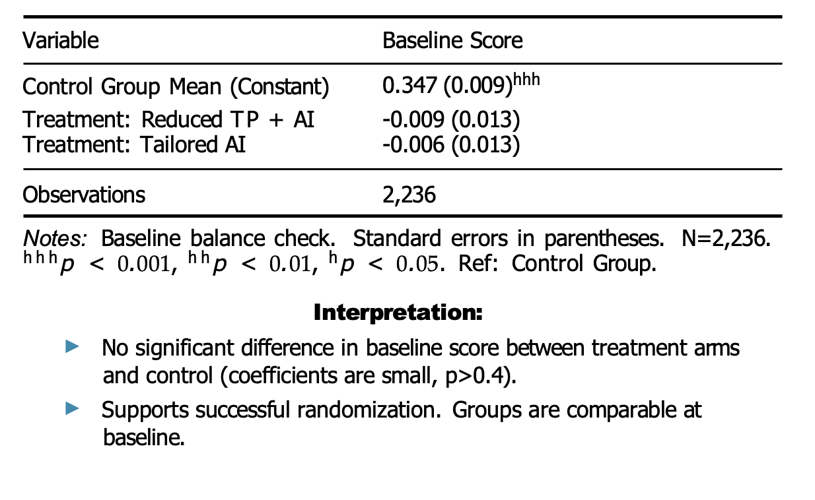
Randomization Check: Baseline Score Balance
Figure: : Kernel density plot of baseline financial literacy scores for Control (likely Blue), Treatment 1 (Reduced TP+AI, likely Green), and Treatment 2 (Tailored AI, likely Red). Distributions appear very similar.

Slide 13
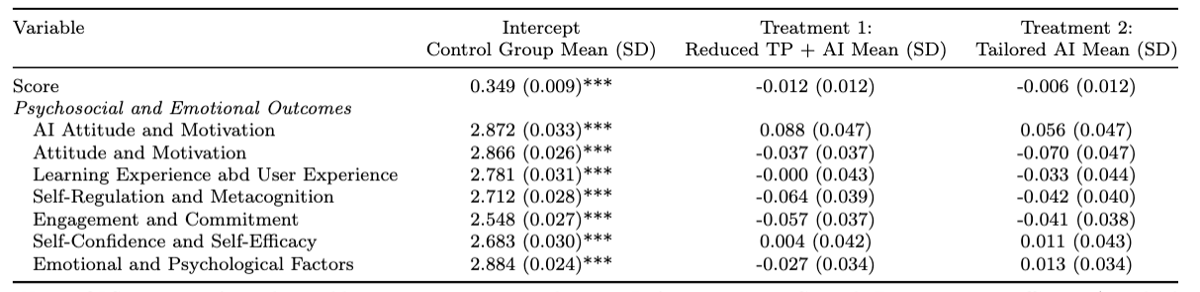
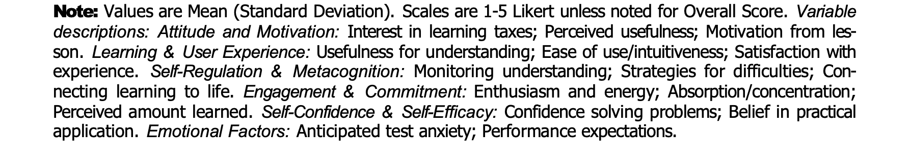
Baseline Outcomes Balance

Slide 14
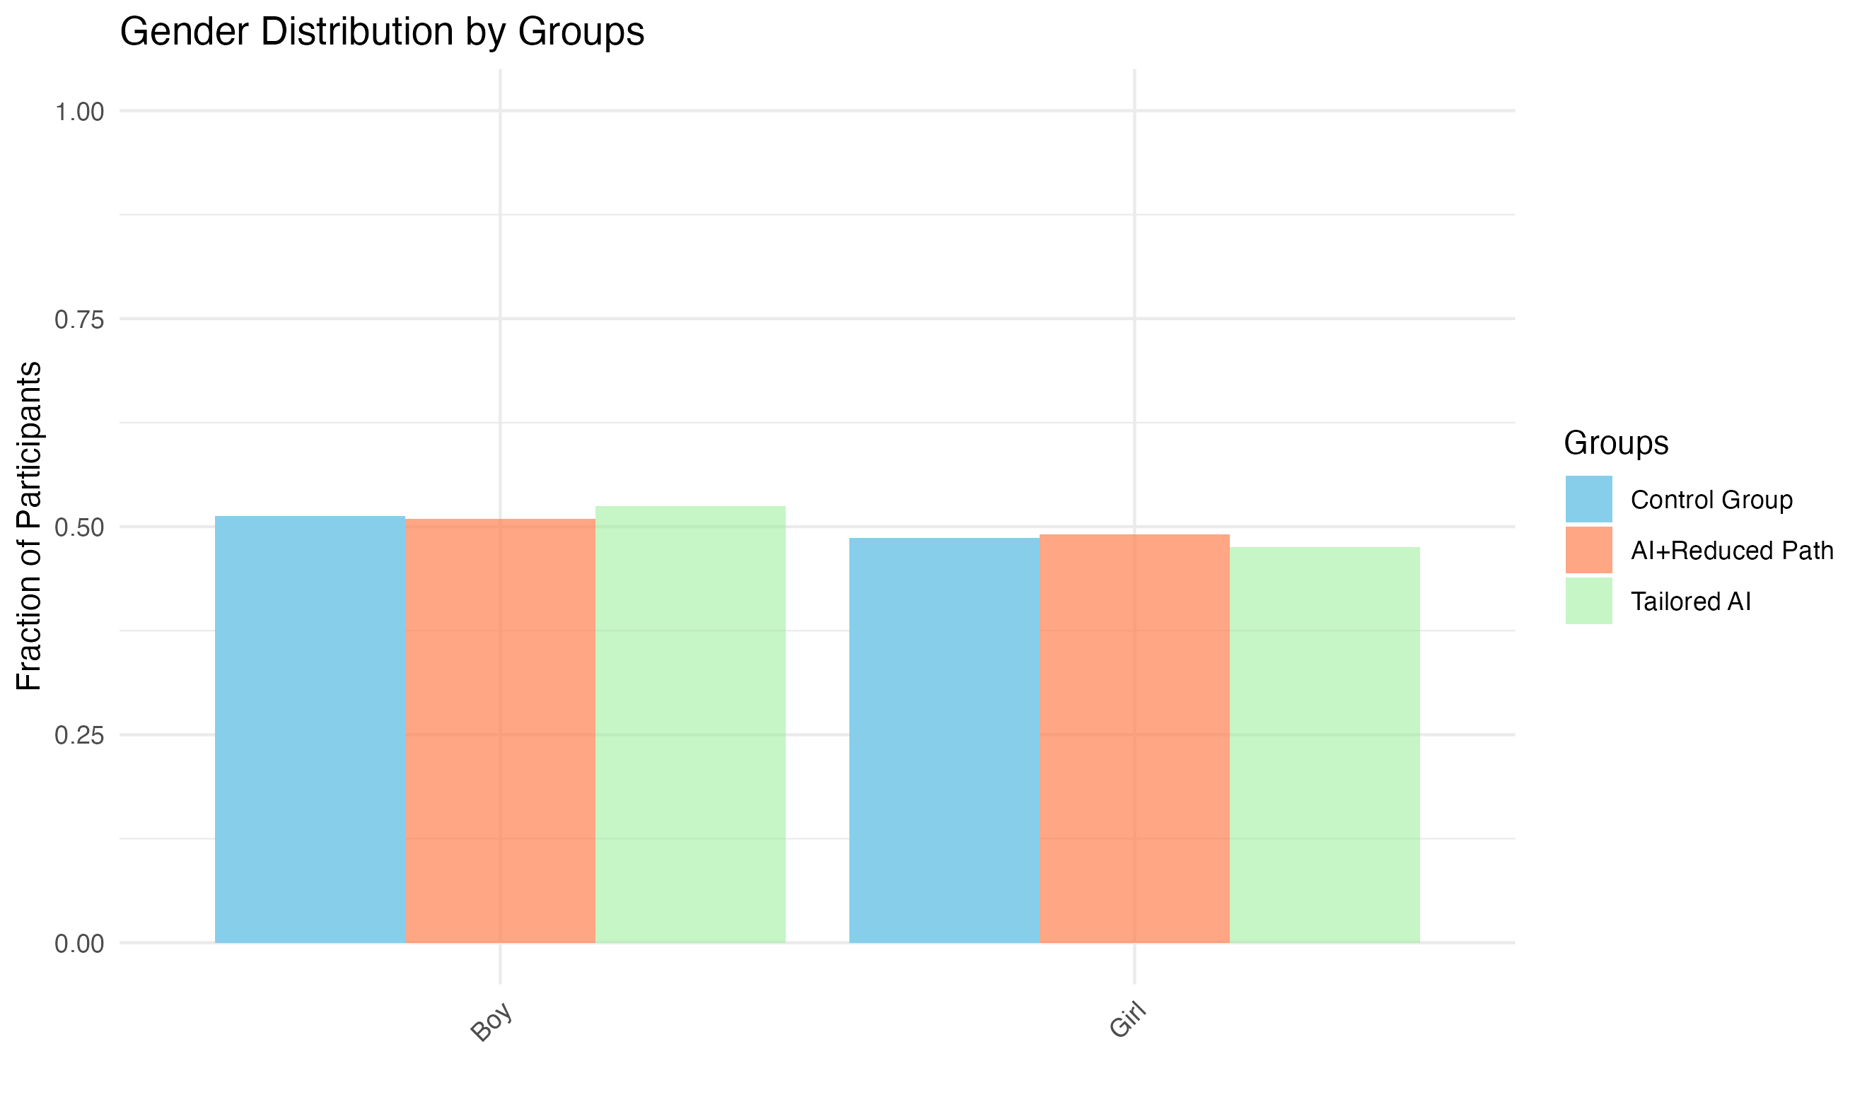
Baseline Characteristics: Gender Balance
Gender distribution compared across groups at baseline.
Test: Pearson’s χ2(2) = 1.61, p = 0.81.
Conclusion: Groups well-balanced on gender.

Slide 15
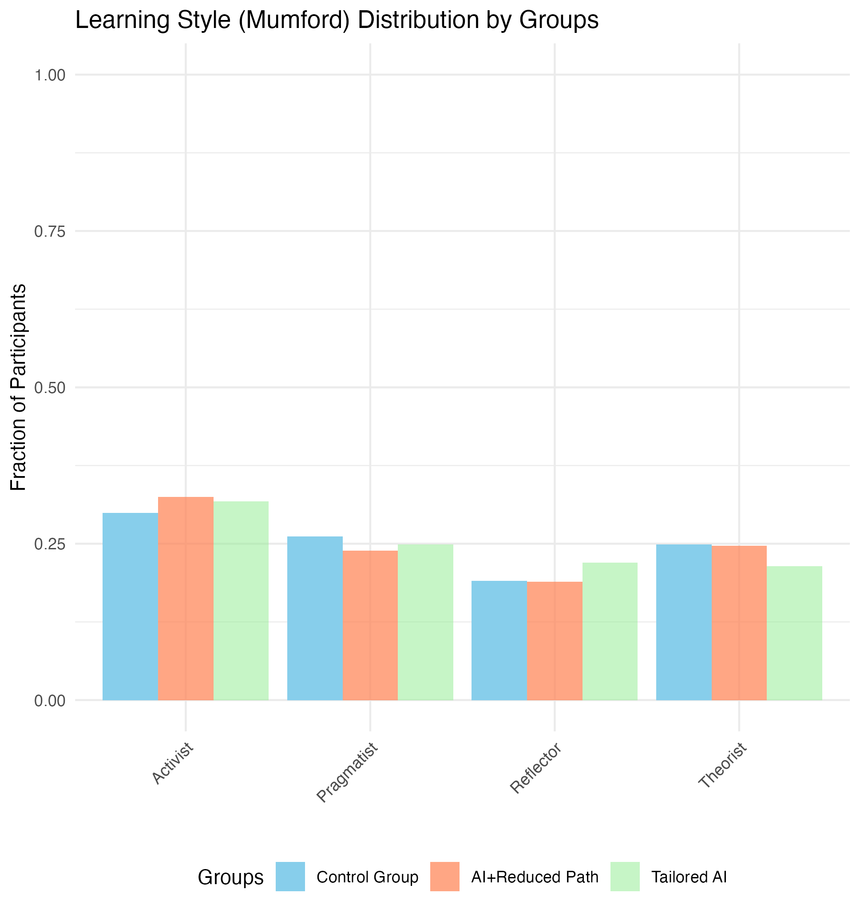
Baseline Characteristics: Learning Style (Murford) Balance
Learning Style distribution compared across groups at baseline.
Test: Pearson’s χ2(6) = 10.4, p = 0.11
Honey and Mumford Learning Style:
Activist: Learns best by doing and experiencing.
Reflector: Learns best by observing and thinking things through.
Theorist: Learns best by understanding concepts, and the logic behind things.
Pragmatist: Learns best when they see a practical application

Slide 16
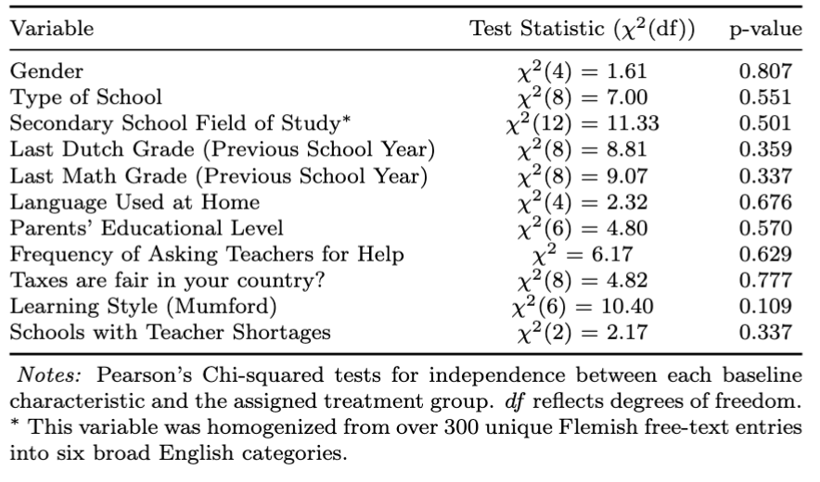
Baseline Balance: Categorical Variables
Notes:
degrees of freedom (df)

Slide 17
Results
4
17
17
Faculty, department, unit ...
Faculty, department, unit ...

Slide 18
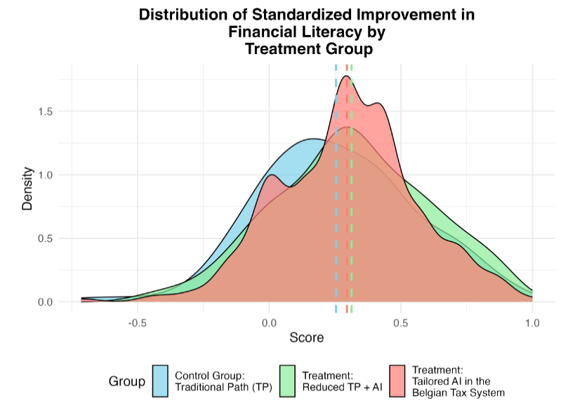
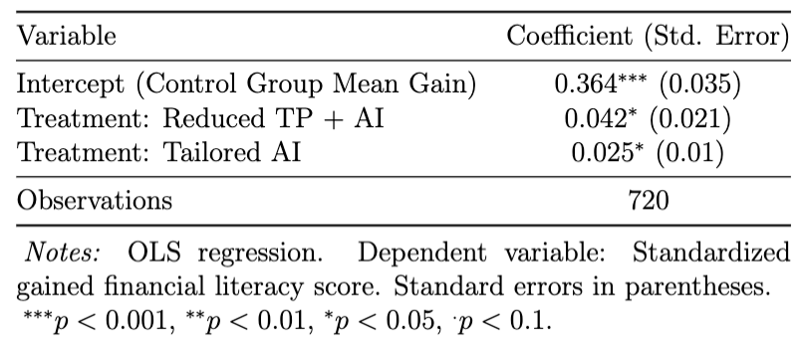
Main Result - Gained Learning
Figure: Kernel density plot of gained learning observed in financial literacy scores

Slide 19
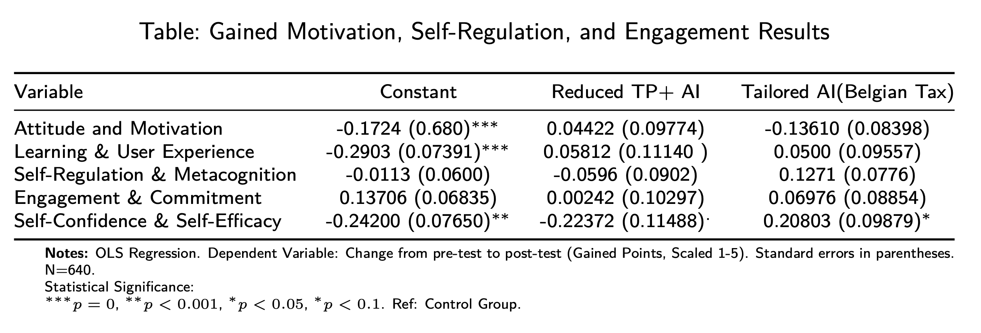
Motivation, Self-Regulation, and Engagement Results

Slide 20
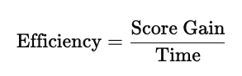
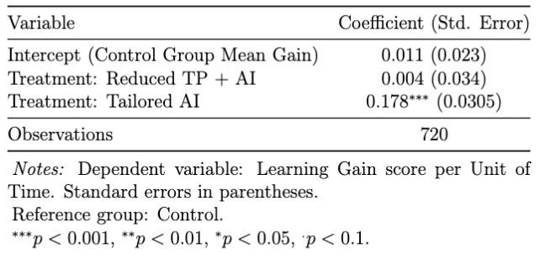
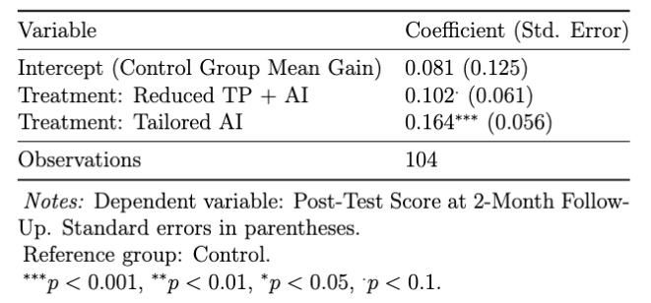
Main Result - Efficiency
Learning Gain per Unit of Time
Long-term learning efficiency

Slide 21
Heterogeneities
3
21
21
Faculty, department, unit ...
Faculty, department, unit ...

Slide 22
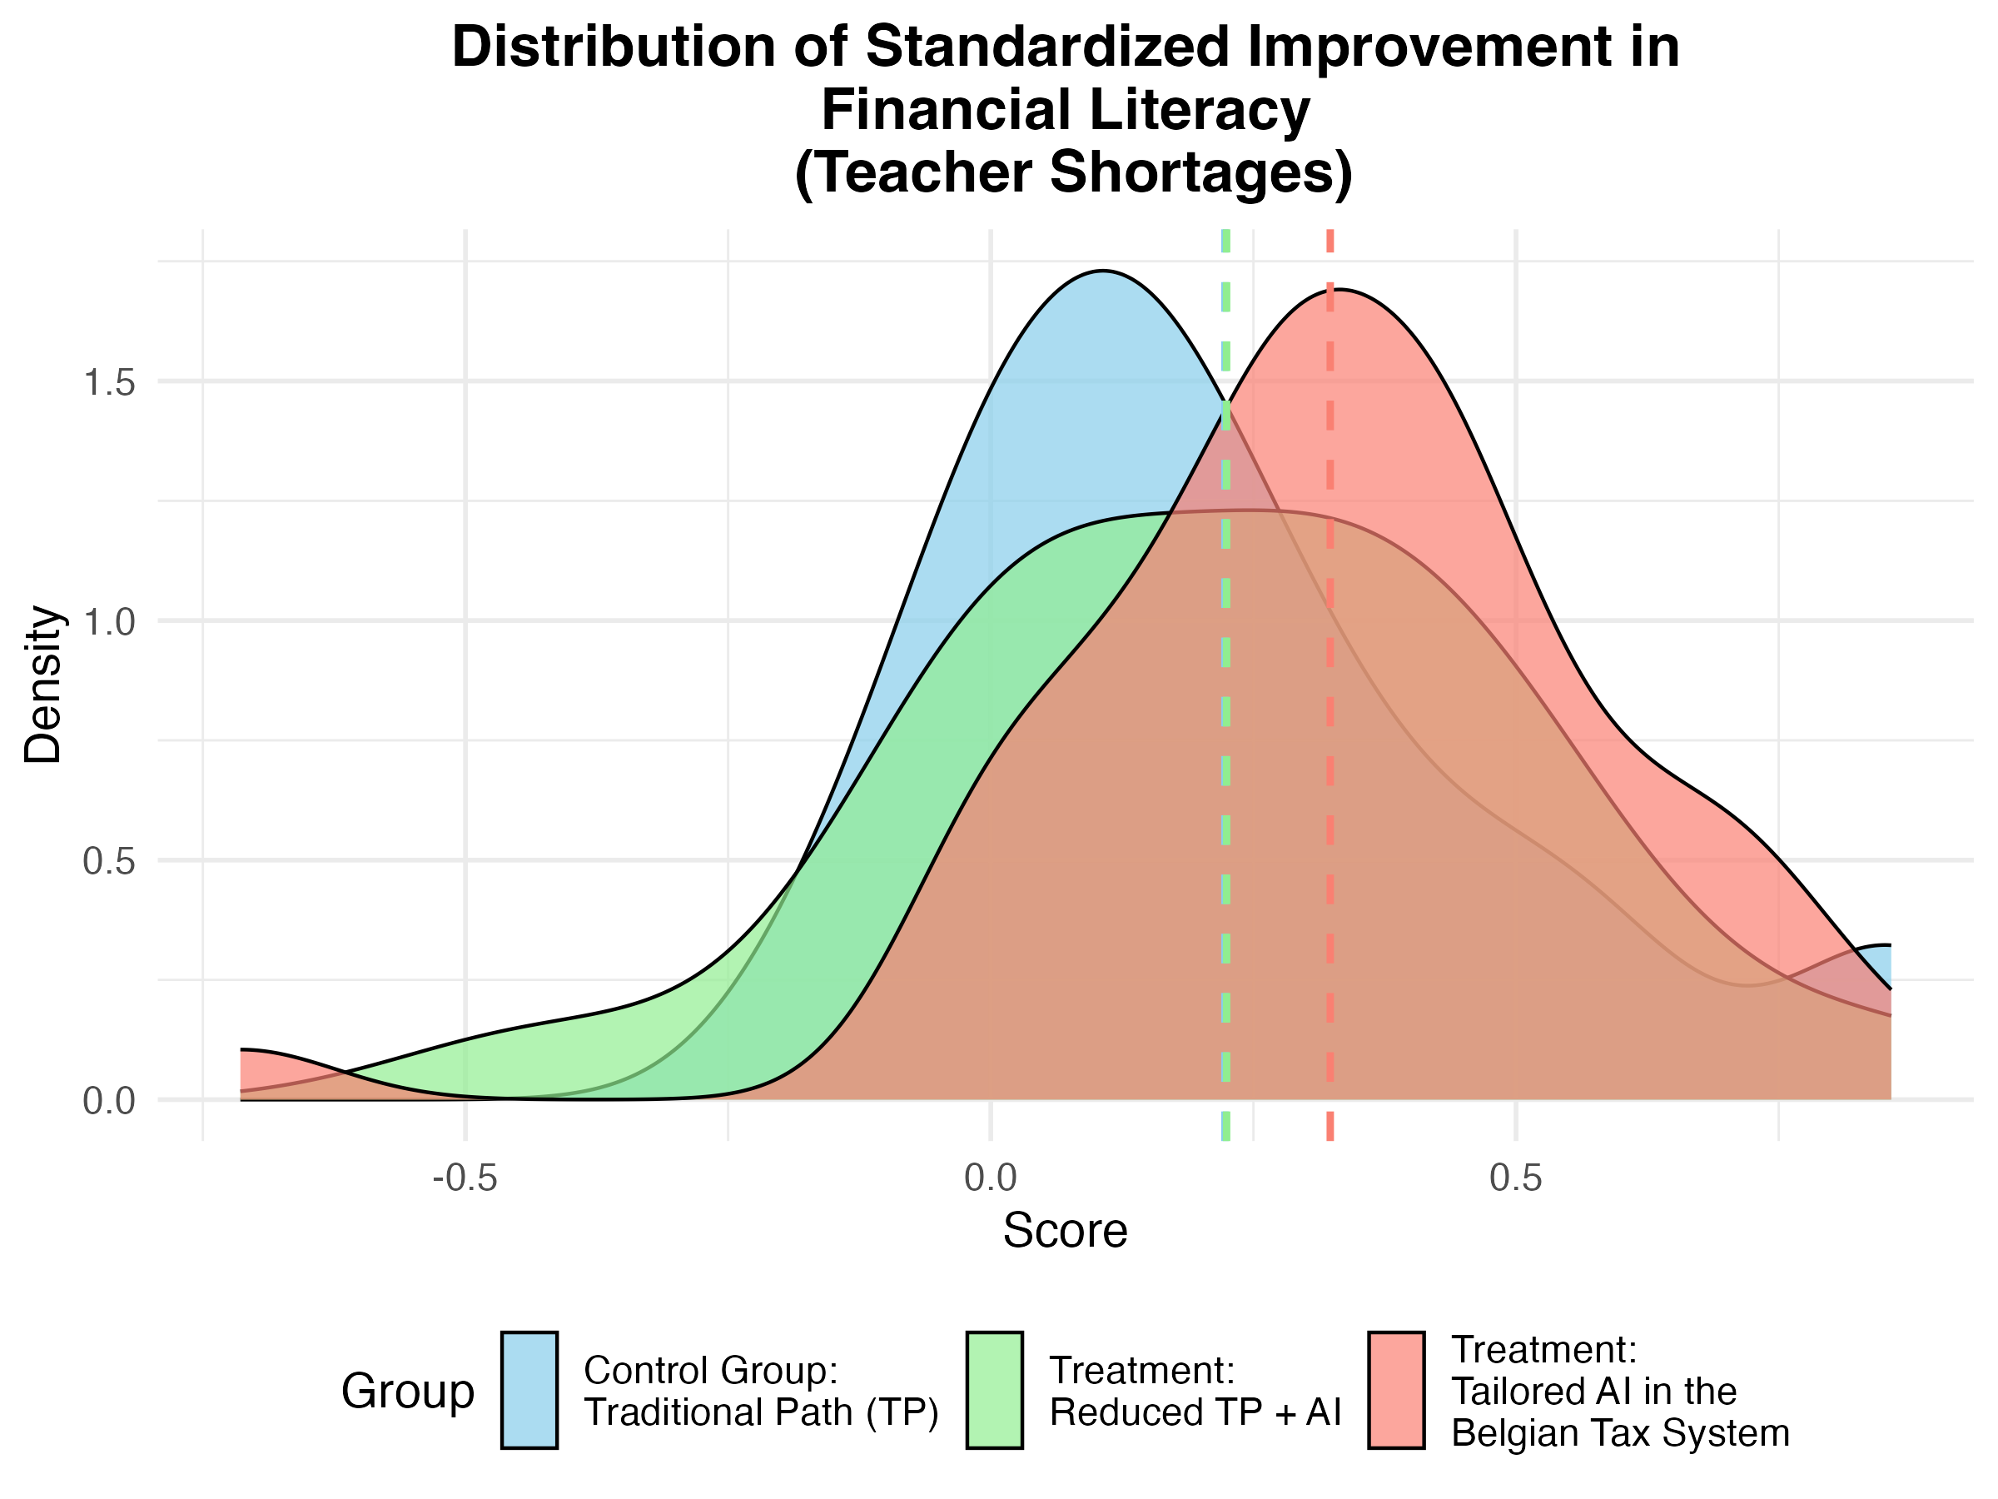
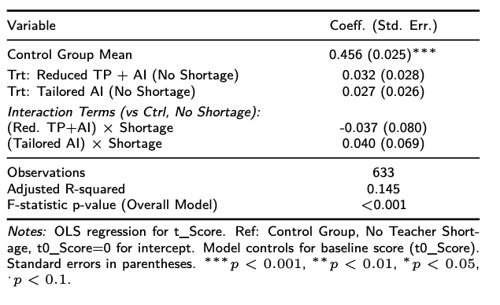
Schools with Teacher Shortages - Gained Learning
In this model, we did not find statistically significant evidence that the interventions (Reduced TP + AI, Tailored AI) had a different impact on post-intervention scores in schools with teacher shortages compared to schools without them.
Figure: Kernel density plot of gained learning observed in financial literacy scores

Slide 23
Robustness
6
23
23
Faculty, department, unit ...
Faculty, department, unit ...

Slide 24
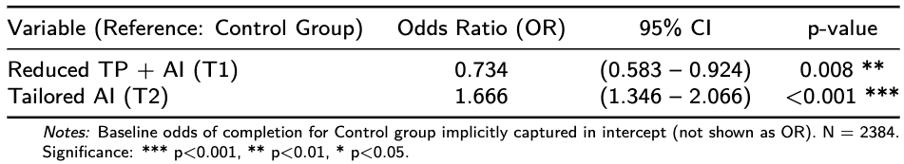
The Challenge of Attrition in RCTs
We formally assess if compliance (i.e., completing the intervention) differs based on the randomly assigned treatment group. This examines if there's differential treatment uptake.
Where: Where: Completed_{i} = 1 if student i completed the intervention, 0 if attrited. AssignedGroup_{i} is the initial random assignment. We examine the Odds Ratios (e^{β1} ).
Interpretation:
Students in the Reduced TP + AI group had significantly lower odds (approx. 26.6% lower) of completing, suggesting lower treatment uptake or higher disutility of participation for this arm.
Students in the Tailored AI group had significantly higher odds (approx. 66.6% higher) of completing, indicating higher compliance or perceived utility.
Conclusion: Attrition is non-random with respect to treatment assignment. This differential compliance implies that analyses on completers only may suffer from selection bias.

Slide 25
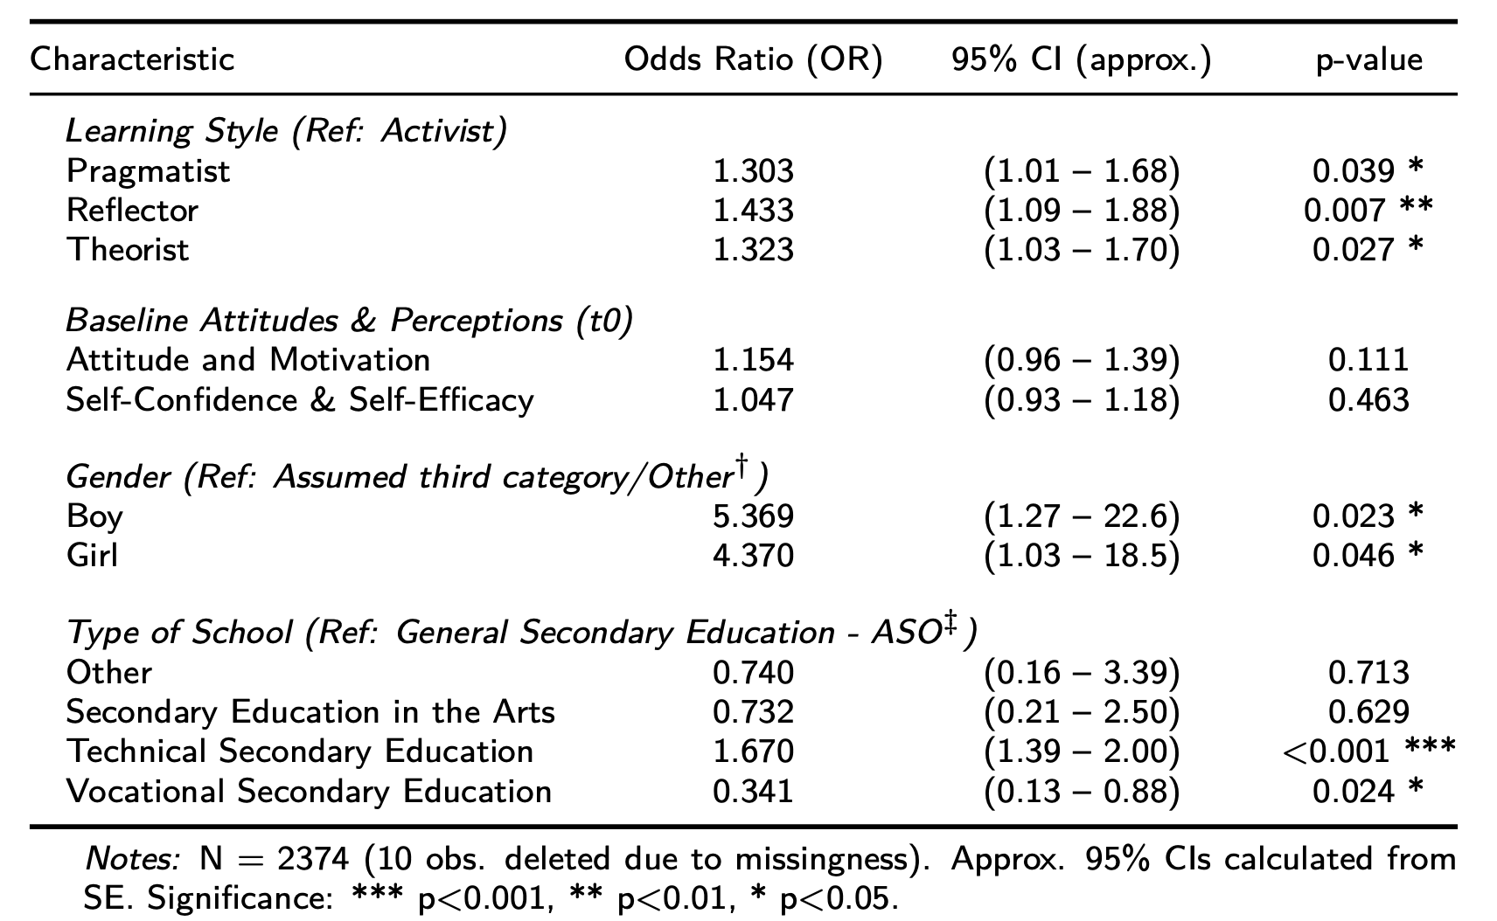
Attrition Check: Evidence of Selection on Pre-Treatment Characteristics
We further use logistic regression to investigate if attrition is related to baseline student and school characteristics, which could indicate selection on observables among those who complete.
Key Finding: The sub-sample of completers is systematically different from the original randomized sample based on observable pre-treatment characteristics

Slide 26
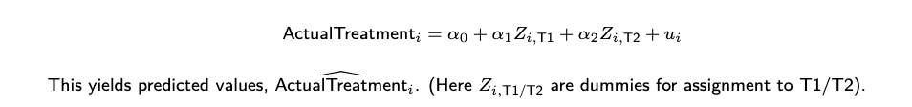
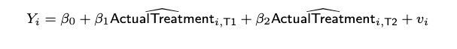
The IV Mechanism: Two-Stage Least Squares (2SLS)
The Two Stages:
First Stage: Predict actual treatment received/completed (the endogenous regressor, ActualTreatment_{i}) using the exogenous randomly assigned group (the instrument, Zi).
Second Stage: Estimate the effect of this instrumented (exogenously driven component of) treatment on Gained Learning (Y_{i}).
β₁ and β₂ estimate the Local Average Treatment Effect (LATE) for each treatment arm relative to the control: the causal effect for compliers—those students whose participation was influenced by the initial random assignment.

Slide 27
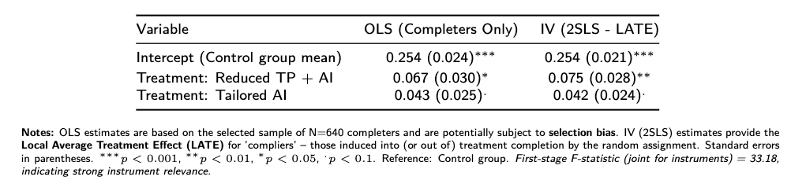
Comparing Estimates: OLS (on Completers) vs. IV (LATE)
Interpretation Points:
The LATE for "Reduced TP + AI" (0.075 sd) is slightly larger and more significant than its OLS counterpart, suggesting OLS might have underestimated the effect for compliers.
The LATE for "Tailored AI" (0.042 sd) is very similar to OLS, implying that for this arm, selection effects among completers might be less pronounced or net out regarding the LATE.
LATE identifies effects for a specific sub-population (compliers); differences from OLS can reflect both bias correction and estimation on different populations defined by compliance behavior

Slide 28
The Impact of AI-Supported Learning on Financial Literacy: Evidence from a Randomized Controlled Trial
Thanks!
Jaime Polanco-Jimenez
jaime.polancojimenez@kuleuven.be
+573002737490
Kristof De Witte
kristof.dewitte@kuleuven.be

